Slide 1

Customer Purchasing Capabilities
Written By | Subhabhrata Nath, Vinayak Dumbre
Document Version | 1.0
Last Revised Date | 2nd,oct,2021

Slide 2
OBJECTIVES
Customer Segmentation is the subdivision of a market into discrete customer groups
that share similar characteristics. For bank it’s necessary to group there customers based on there expenditure . And this segmentation will help them to advirtise there customer for new product.
BENEFITS
By customer segmentation companies got to know about group of customers for a particular product or services.
Customer Segmentation can be a powerful means to identify unsatisfied customer needs.
companies can then outperform the competition by developing uniquely appealing products.

Slide 3
Data Description
feature name | type | description
BALANCE | float | Balance amount left in customers account to make purchases
BALANCE_FREQUENCY | float | How frequently the Balance is updated, score between 0 and 1
PURCHASES | float | Amount of purchases made from account
ONEOFF_PURCHASES | float | Maximum purchase amount done in one-go
INSTALLMENTS_PURCHASES | float | Amount of purchase done in installment
CASH_ADVANCE | float | Cash in advance given by the user
PURCHASES_FREQUENCY | float | How frequently the Purchases are being made, score between 0 and 1
ONEOFFPURCHASESFREQUENCY | float | How frequently Purchases are happening in one-go
PURCHASESINSTALLMENTSFREQUENCY | float | How frequently purchases in installments are being done
CASHADVANCEFREQUENCY | float | How frequently the cash in advance being paid
CASHADVANCETRX | int | Number of Transactions made with "Cash in Advanced"
PURCHASES_TRX | int | Numbe of purchase transactions made
CREDIT_LIMIT | float | Limit of Credit Card for user
PAYMENTS | float | Amount of Payment done by user
MINIMUM_PAYMENTS | float | Minimum amount of payments made by user
PRCFULLPAYMENT | float | Percent of full payment paid by user
TENURE | int | Tenure of credit card service for user

Slide 4
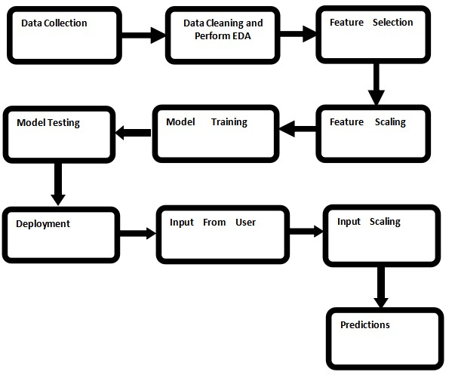
Architecture

Slide 5
Architecture Flow
1. Data gathering:
Data source: https://www.kaggle.com/arjunbhasin2013/ccdata?select=CC+GENERAL.csv
Train and Test data are stored in .csv format.
2.Data-Preprocessing
we cleaned our data by removing null values because they were very less in number.
we apply Min-Max scaling to scale-down data. and we save this model to scale down user input for future purpose.
we use elbow method to find out number of clusters.we saved this model for cluster prediction of user input.
Then we perform principle component analysis to convert the features in no of clusters we got in step 3 and for visualization purpose.

Slide 6
Model Training:
we train our data on different unsupervised machine learning algorithms like k-means,DBscan, Hierarchical clustering and we get best performance with k-means clustering.
we use elbow method to find out number of clusters.we saved this model for cluster prediction of user input.
Then we perform principle component analysis to convert the features in no of clusters we got in step 3 and for visualization purpose.
Model Saving:
we save this model for cluster prediction of user input.

Slide 7
Flask setup for data extraction:
After saving the model, API building process started using Flask. Web application creation was created here. we have integrated ui with the app by which user can give data on web browser and get the prediction.Whatever the data user will enter and then application will gives the number of group that data belongs.
Github:
https://github.com/Vinayak-HUB1/PURCHASING_CAPABILITIES_
Deployment:
cpc1.herokuapp.com

Slide 8
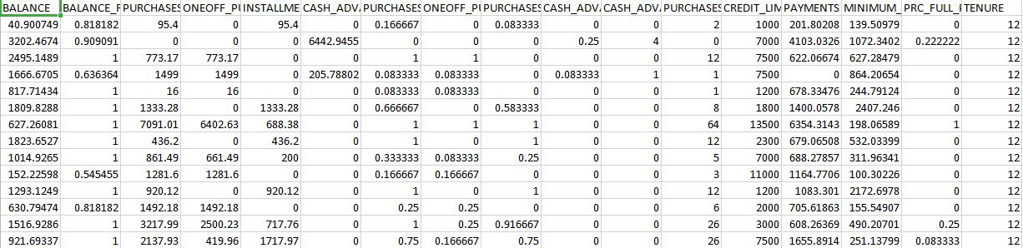
Data set description
The Dataset we have use contain all relevant information of customers for prediction there purchasing capability and analysis the insight about there purchasing pattern. The dataset contain `Balance`, `Purchase Frequency` and these information will help to divide the groups.

Slide 9
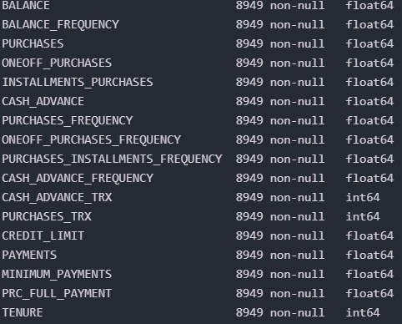
The types of data that dataset contains is shown below

Slide 10
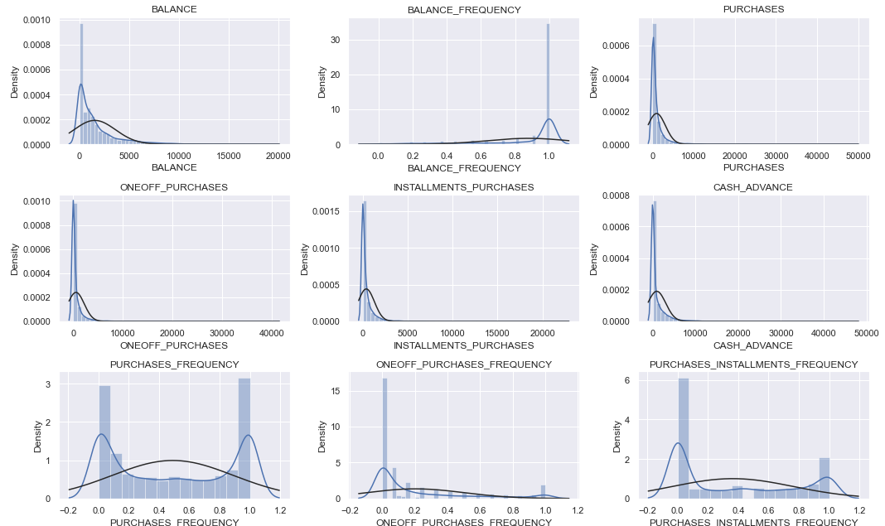
Data Observation: as all the column are in numerical type, plotting distribution plot for checking the overview.

Slide 11
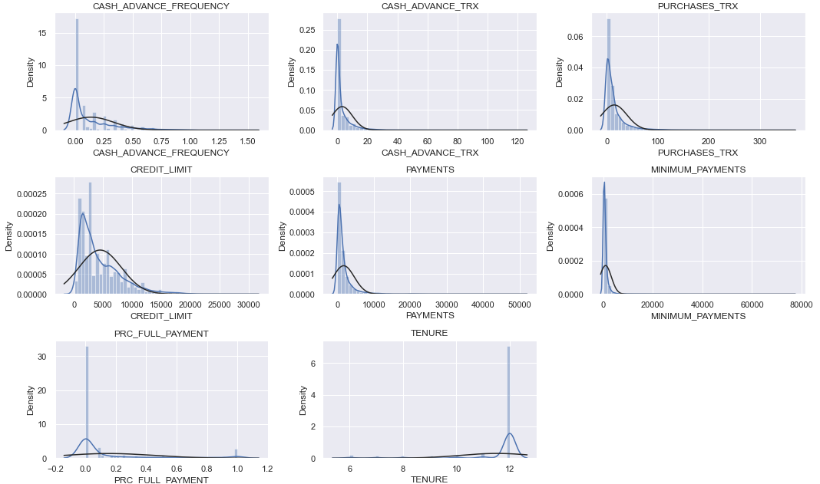
Data Observation:

Slide 12
Observation
All the features are present in the data is numerical in nature. No further label encoding is required. And from the distribution graph we can observe that most of the feature are in skewed and for that we have used scaling.

Slide 13
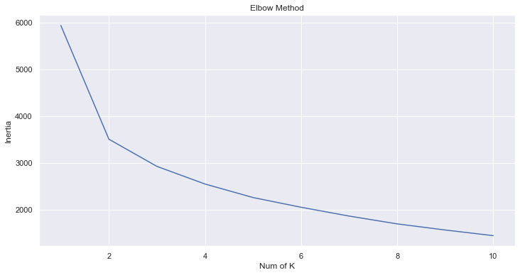
Elbow Plot.
From Here we have consider 3 as our cluster number.

Slide 14
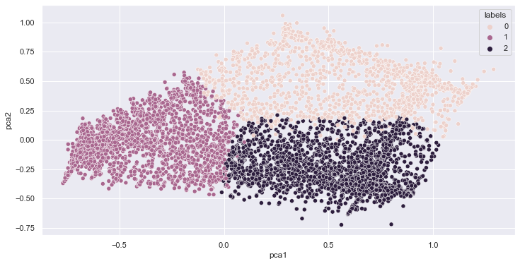
Clusters.
We have plot cluster to see the spread. Based on 3-k three cluster have been made.

Slide 15
Metrics:
The range of Silhouette score is [-1, 1]. Its analysis is as follows −
+1 Score − Near +1 Silhouette score indicates that the sample is far away from its neighboring cluster.
0 Score − 0 Silhouette score indicates that the sample is on or very close to the decision boundary separating two neighboring clusters.
-1 Score − 1 Silhouette score indicates that the samples have been assigned to the wrong clusters.
The calculation of Silhouette score can be done by using the following formula
silhouettescore=(p−q)/max(p,q)
Here, p = mean distance to the points in the nearest cluster
And, q = mean intra-cluster distance to all the points.

Slide 16
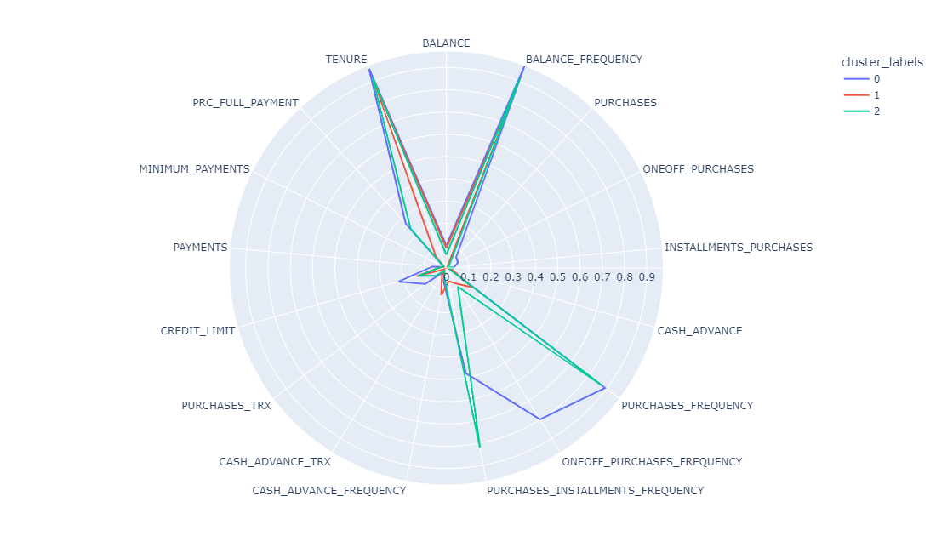
Polar Graph.
Here we can visually observe all the groups behaviour on the features.

Slide 17
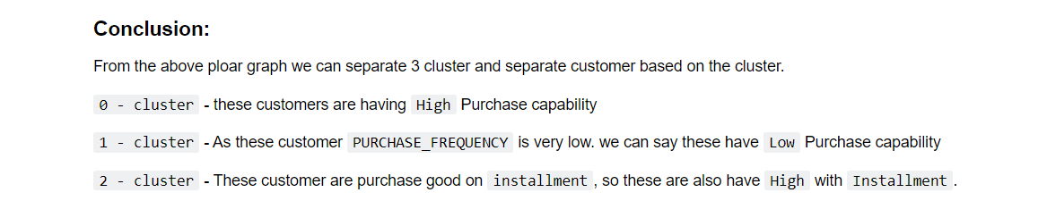
Conclusion.
The following conclusion we have made from the polar graph.

Slide 18
Q & A
Q1) What’s the source of data?
The data for training is taken from kaggle.
Q 2) What was the type of data?
The data was the numerical data.
Q 3) What’s the complete flow you followed in this Project?
Refer slide 4th for better Understanding

Slide 19
Q & A
4. what is customer segmentation?
A.customer segmentation means forming groups of customers based on some of the similar features.
5.how logs are managed?
A.we have a logger which gives logs with respect to every steps of data transformation and predictions.
6.how training was done?
A.at first we handle the null values and scale our data using minmax scaler.then we use k-means clustering to perform clustering.

Slide 20
Q & A
7.what all techniques were used for data Pre-processing?
A. 1.removing null values.
2.scaling using min-max scaler.
8.How training was done,which all models were used?
A. for training we use kmeans,DBscan and hierarchical clustering
methods,kmeans gives us best silhotte score,so we use that for prediction.
9.How Prediction was done?
A. 1.if prediction result is cluster 0,means customers purchasing capability is more.
2.if prediction result is cluster 1,means customer purchasing capability is partial.
3.if prediction result is 2,means customer purchasing capability is less.

Slide 21
Thank you

